Slide 1
Part 11 Compliant Excel Workbooks
Jeffrey Plume

Slide 2
Audit Trail
The SheetChange event is triggered whenever a cell's content is changed in any worksheet within the workbook.
Use of secure, computer-generated, time-stamped audit trails to independently record the date and time of operator entries and actions that create, modify, or delete electronic records. Record changes shall not obscure previously recorded information.
21 CFR Part 11 Subpart B

Slide 3
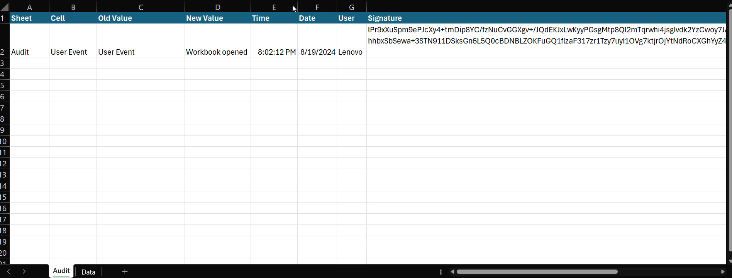
Audit Trail
The SheetChange event is triggered whenever a cell's content is changed in any worksheet within the workbook.

Slide 4
Security Controls
Persons who use electronic signatures based upon use of identification codes in combination with passwords shall employ controls to ensure their security and integrity.
21 CFR Part 11 Subpart B

Slide 5
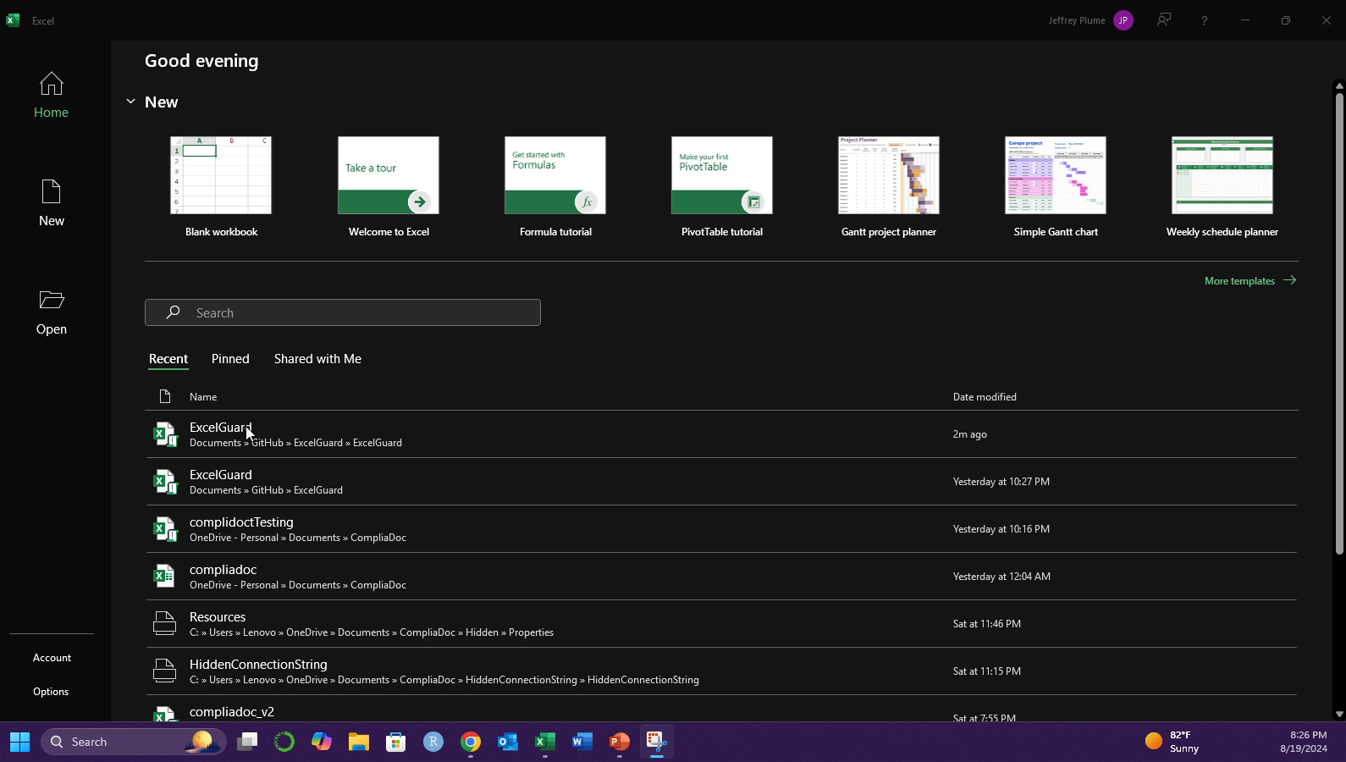
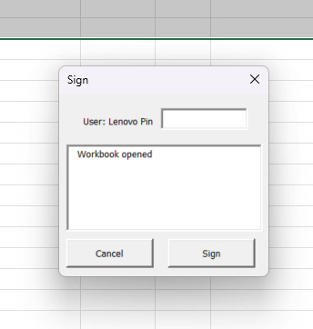
Pin Protected (in addition to standard protections)

Slide 6
Digital Signatures
Persons who use open systems to create, modify, maintain, or transmit electronic records shall employ procedures and controls designed to ensure the authenticity, integrity, and, as appropriate, the confidentiality of electronic records from the point of their creation to the point of their receipt. Such procedures and controls shall include those identified in § 11.10, as appropriate, and additional measures such as document encryption and use of appropriate digital signature standards to ensure, as necessary under the circumstances, record authenticity, integrity, and confidentiality.
21 CFR Part 11 Subpart B

Slide 7
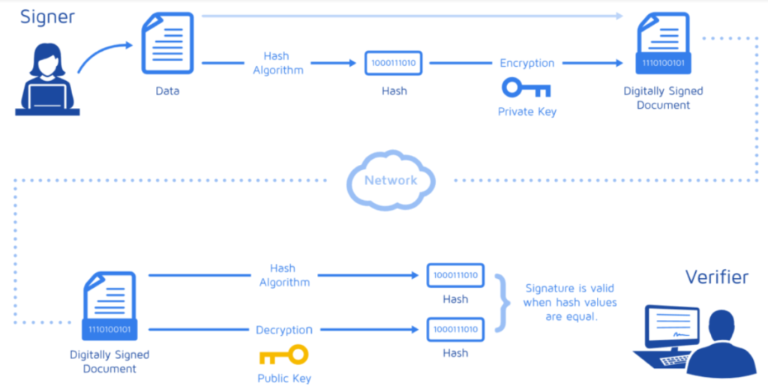
Mechanism
Source: DocuSign

Slide 8

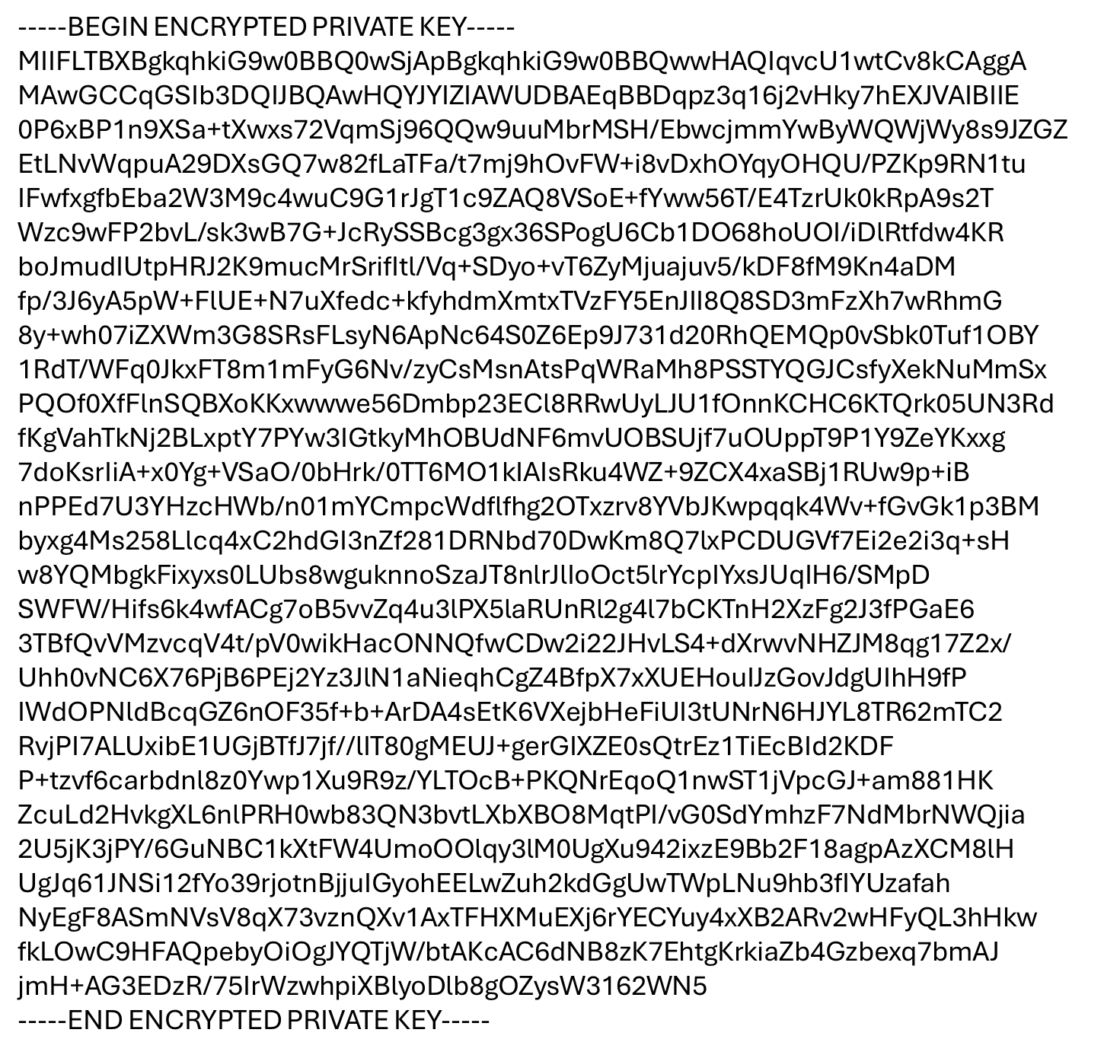
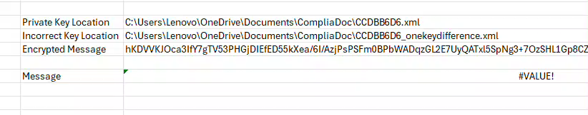
Signature Encrypted with Private Key
Public Key Stored with in separate file in secure location

